Slide 1
Software Quality Assurance and Testing
Lecture -10
Harish Aggarwal

Slide 2
Re-Cap
Lecture - 01
Definitions – S/W Quality, S/W Quality Assurance
Importance of QA
Causes of Defects
Business Models in S/W
S/W Cost, Quality Cost
Quality culture
Lecture - 02
Software Quality Models
McCall, IEEE 1061, ISO 25000 Series
Quality Requirements
Quality of Requirements
Frameworks
ISO/IEC/IEEE 12207 - Software Life Cycle Processes
Lecture - 03
Frameworks
CMMI-Development
ITIL Framework
Other Frameworks
Lecture - 04
ISO 25010 – Quality Attributes
Functional Suitability, Performance Efficiency, Compatibility, Usability, Reliability, Security, Maintainability, Portability
Lecture - 05
Software Testing Fundamentals
Software Verification and Validation
Types of Testing - Black Box, White Box Testing
Test Levels and Types –
Unit, Integration, System Testing

Slide 3
Re-Cap
Lecture - 06
Test Design Techniques
Combinatorial Testing
Boundary Value Analysis
Equivalence Class Partitioning
Lecture - 07
Test Methodology
Decision Table Testing
Test Execution Process
Test Case Design
Automated Testing
Alpha and Beta Site Testing
Regression Testing Strategies
Lecture - 08
Revision
Lecture - 09
Reviews - Informal Reviews, Formal Reviews
Personal, Peer, Walkthrough, Inspection, Audits
Types of Audits (Internal, Third Party)
Project Assessment and Control Process
Corrective Actions

Slide 4
Agenda
Software configuration Management
Definitions
Benefits
SCM vis-à-vis IEEE 828, ISO 12207, CMMi-Dev
Baseline
Branching
Change Control

Slide 5
Software configuration Management
Definition
Configuration Management : Discipline applying technical and administrative direction and surveillance to:
Identify and document the functional and physical characteristics of a configuration item
Control changes to those characteristics,
Record and report change processing and implementation status, and
Verify compliance with specified requirements.
IEEE 828 [IEE 12b]

Slide 6
Software configuration Management
Essentially, SCM describes answers to the following questions :
who can make changes?
what changes were made?
what were the impacts of a change?
when did this change occur?
why were these changes made?
what version is currently in which environment?
what branching approach are we using for this project ?

Slide 7
SCM - Benefits
Benefits :
Reduce confusion, organize, and better manage software items
Organize the required activities that ensure the integrity of the many software products
Ensure traceable and current configuration of products
Optimize the cost of development, maintenance, and after-sales support
Facilitate the validation of the software with respect to its requirements
Provide stable development, maintenance, testing, and production environments
Improve quality and compliance to software engineering standards
Reduce rework costs

Slide 8
SCM
IEEE 828
IEEE Standard for Configuration Management in Systems and Software Engineering
IEEE 828 also supports the ISO 12207 standard
As per IEEE 828, the purpose of CM is to
Identify and document the functional and physical characteristics of a product, component, output or of a service
Control any changes to these characteristics
Record and report each change and its implementation status
Support the audit of the products, results, services, or components to verify conformance to requirements.

Slide 9
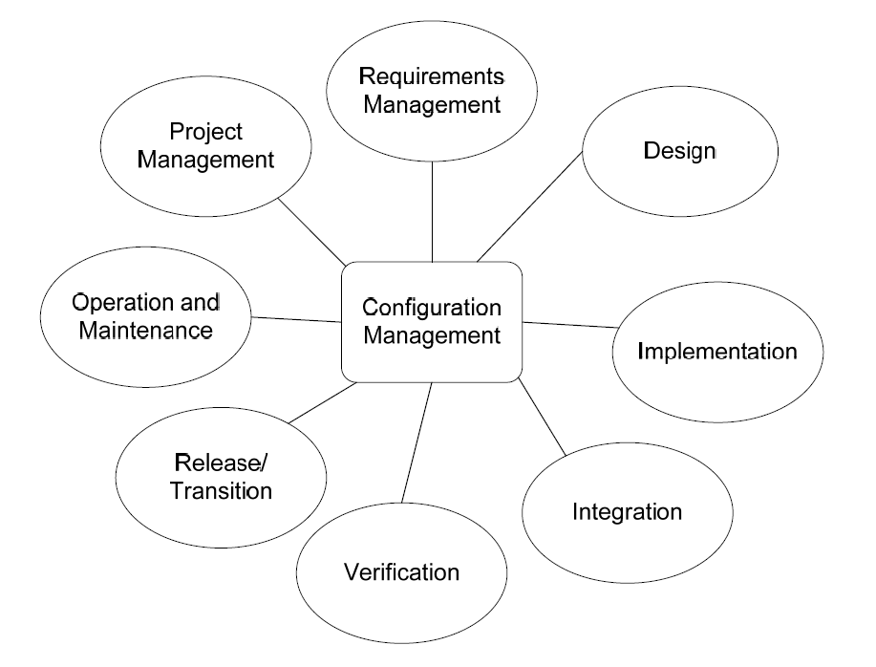
SCM
IEEE 828
Example life cycle processes that CM supports

Slide 10
SCM
ISO 12207
According to the ISO 12207 standard, the purpose of CM is to manage and control system elements and configurations over the life cycle.
In ISO 12207 Standard – SCM is part of SQA practices
Outcome CM process -
A software configuration management strategy is developed
Items generated by the process or project are identified, defined and baselined
Modifications and releases of the items are controlled
Modifications and releases are made available to affected parties
The status of the items and modifications are recorded and reported
The completeness and consistency of the items is ensured
The storage, handling and delivery of the items are controlled.

Slide 11
SCM
ISO 12207
The six activities of the ISO 12207 CM process are [ISO 17]:
Process Implementation - Plan CM - Shall describe –
Configuration management activities
Procedures and schedule for performing these activities
Who is responsible for performing these activities
The plan shall be documented and implemented
Perform configuration identification – The documentation that establishes the baseline; the version references; and other identification details.
Perform configuration change management
Perform release control
Perform configuration status accounting
Perform configuration evaluation.
These Six CM activities of ISO 12207 are composed of 19 tasks.

Slide 12
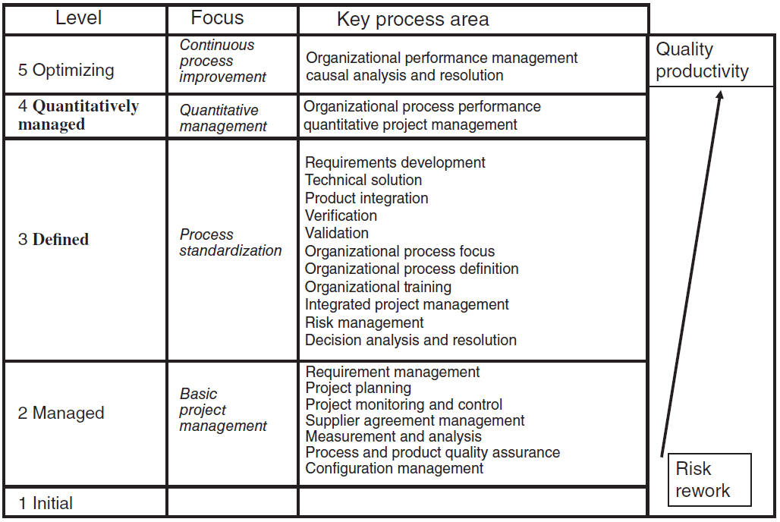
SCM
CMMI
The CMMI-DEV has a process area named “configuration management”
Activities to be conducted as per CMMI-Dev
Identifying the configuration of selected work products that compose baselines at given points in time
Controlling changes to configuration items (CI)
Building or providing specifications to build work products from the CM system
Maintaining the integrity of baselines
Providing accurate status and current configuration data to developers, end users, and customers.

Slide 13
SCM
CMMI
Specific Objectives (Goals) and Practices as per CMMI-Dev
SG 1 Establish baselines
SP 1.1 Identify configuration items
SP 1.2 Establish a configuration management system
SP 1.3 Create or release baselines
SG 2 Track and control changes
SP 2.1 Track change requests
SP 2.2 Control configuration items
SG 3 Establish integrity
SP 3.1 Establish configuration management records
SP 3.2 Perform configuration audits

Slide 14
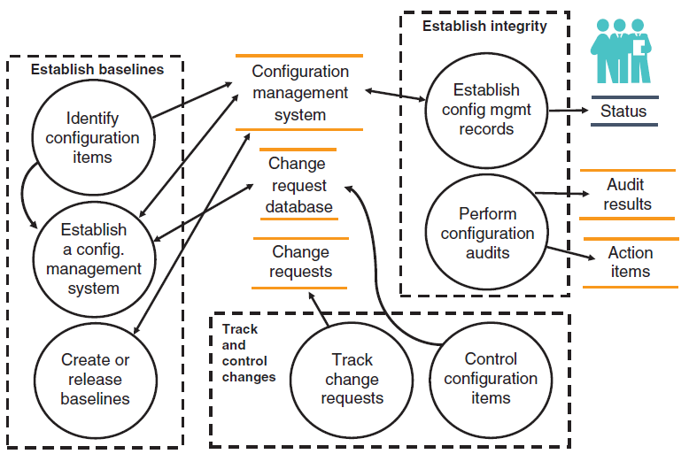
SCM
CMMI
CM activities according to CMMI

Slide 15
SCM - Plan
IEEE 828 defines six SCM information categories to be placed in the SCM plan –
Introduction to the plan (the purpose, scope, and terminology)
SCM management (organization, responsibilities, authorities, applicable policies, guidelines, and procedures)
SCM activities (configuration identification, configuration control, and other activities)
SCM schedule (identification of the SCM activities in the project schedule)
SCM resources (tools, servers, and human resources)
SCM maintenance and updates.

Slide 16
SCM – Plan
Identification of CI
Each CI should be assigned a unique identifier.
Identifier is composed of a fixed part and a variable part.
Fixed part is Name
Variable part (Revision/Version/BuildNo) is evolution
Revision – Major release is made. New feature, new functionality, etc
Version – Minor bug fixes, etc
Build No – Rolling Number every time a build is generated

Slide 17
SCM – Plan
Identification of CI
Delivery - Release of a system or component to its customer or intended user.
Release - A delivered version of an application that may include all or part of an application.
Collection of new and/or changed configuration items that are tested and introduced into the live environment together.
Version - An initial release or re-release of a computer software configuration item, associated with a complete compilation or recompilation of the computer software configuration item.
An initial release or complete re-release of a document, as opposed to a revision resulting from issuing change pages to a previous release.
ISO 24765 [ISO 17a]

Slide 18
Baselines
State of a Configuration Item at the end of a stage or beginning of a new stage.
This baseline is used for the next stage or for the entire project.
It is reviewed, finalized, fixed and approved.
Any changes to the baselines represent current configuration.
Commonly referred baselines -
Specification
Design
Construction
Integration
Validation
Delivery

Slide 19
Baselines
Documents that can be baselined
Design documents
Software development plan (SDP)
Software requirements document (SRD)
Interface design specifications
Preliminary design document (PDD)
Critical design document (CDD)
Database description
Software test plan (STP)
Software test procedure (STPR)
Software test report (STR)
Software user manuals
Software maintenance manuals
Software installation plan (SIP)
Software code
Source code
Object code
Prototype software
Data files
Test cases and test scripts
Parameters, codes, etc.
Software development tools
(the versions applied in the development and maintenance stages)
Compilers and debuggers
Application generators
CASE tools

Slide 20
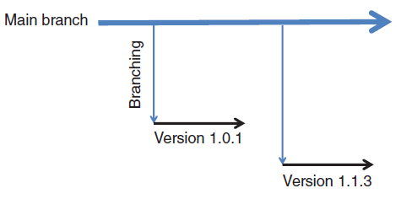
Branching
Branching is needed because
Multiple people are working on project – Development team, Test Team
Project is evolving continuously
A simple Branching Strategy
The main branch;
The versions branch.
Development happens on the main Branch.
Anytime a version is delivered to customer, a version branch is created
This strategy is appropriate when:
A very small team is working on the project
Corrections to production software require a fusion to the main branch.
New version shipped from the main branch includes all previous changes from this branch.

Slide 21
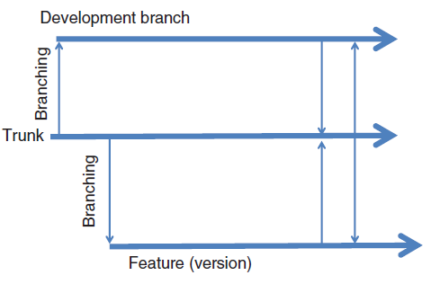
Branching
A Typical Branching Strategy
The main branch;
The development branch;
The production branch
No one works directly in Main Branch
Main branch is used only for integration from Development Branch.
Stable changes from Development branch goes to Main Branch
Stable version of Development branch is forked to Feature (Version) Branch
Bug fixes happen in Feature Branch.
These fixes are merged back into Development Branch and Main Branch.

Slide 22
Configuration/Change control
Configuration control or change control.
Definition -
An element of configuration management consisting of the evaluation, coordination, approval or disapproval, and implementation of changes to configuration items after formal establishment of their configuration identification. CMMI [SEI 10a]
Changes need to be
Evaluated
Co-ordinated
Approved
Implemented On
Configuration Items with established Configuration Identification.

Slide 23
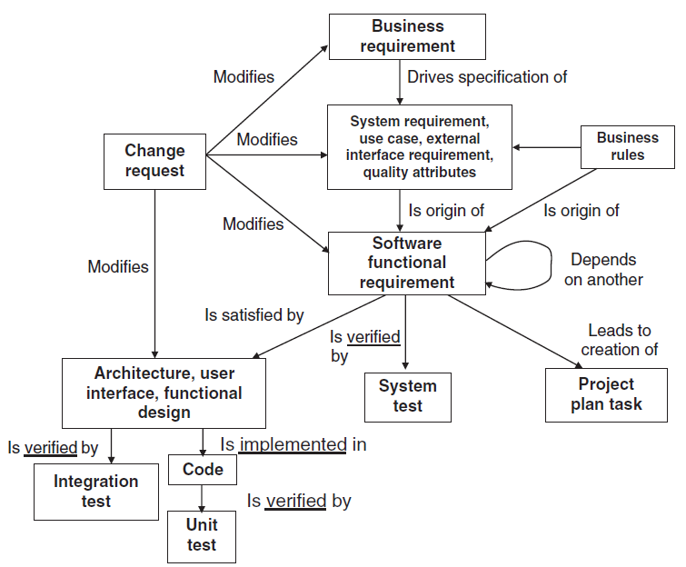
Configuration/Change control
Impact of a change request on a software

Slide 24
Configuration/Change control
Change source
Origin of Changes. Changes can come from -
Problem reports (PR), or Bug report (TR), from
Development team
Maintenance team or
Customer
Modification/evolution requests (MR) due to
An environment change or
The need for new features
Requests from maintenance and infrastructure to
Improve the maintainability of the software.

Slide 25
Configuration/Change control
Phases of change
Sequence of phases of change can be as follows
Customer (internal or external) or a team member submits a request;
Maintainer evaluates the priority, impact and cost
Change Control Committee (CCC) or Configuration Control Board (CCB) reviews and approves the change
Change is made to the software and associated documentation
Change is tested and approved by the end-user
Change is moved to production or installed in a system and verified afterward
Change request or ticket is closed and then later archived.

Slide 26
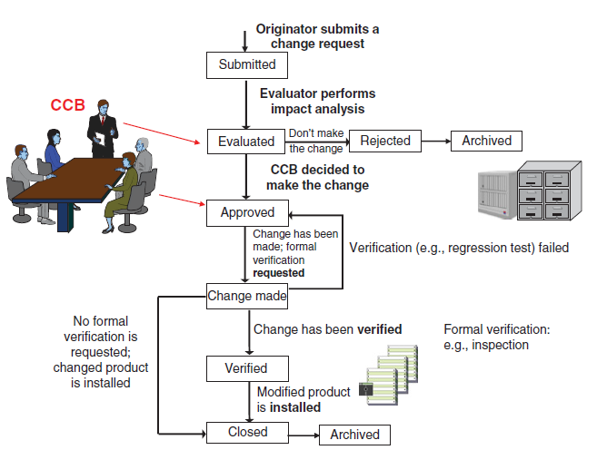
Configuration/Change control
Phases of change

Slide 27
Configuration/Change control
Change control Board
Configuration Control Board
A group of people responsible for evaluating and approving or disapproving proposed changes to configuration items, and for ensuring implementation of approved changes.
ISO 24765 [ISO 17a].
Change control board (CCB) or a change management office
Authority that can accept or reject a proposed change to a software.
Nature of Board depends on Size and nature of the project.
For small projects, even a project manager can act as CCB
SCM representative, SQA representative can be part of CCB

Slide 28
Configuration/Change control
Change control Board
The main tasks of the CCB are:
Take a go/no-go decision
Assign a priority
Reject and assign the change to a future version
Answer request issuers
Issue access rights to libraries where changes are to be made.
Make the decision (change order) public so everybody knows
The change request includes the following
Details of changes to be made.
Identification of the affected software
List of items in a baseline to modify
SQA tasks to ensure quality checks

Slide 29
Configuration/Change control
Change Management Policy
The elements of a change management policy are:
The original text describing a change request will not change or will not be deleted from the repository
Each changed requirement will be traceable to an approved change request
All changes to requirements should follow the SCM process. If a change request is not documented, it will not be considered
A CCB is created for each project
The contents of the change request library must be available to all project team members;
No design or development/maintenance work can be initiated on unapproved changes, with the exception of exploration or feasibility studies required by the CCB.

